Slide 1
CS 587 – Database Management System Implementation Spring 2019
Team: Divya Sravani Vukkusila, Shweta Korulkar

Slide 2
DB of choice: PostgreSQL
We chose to evaluate the script to populate on our local instance of PostGres Database.
Due to our familiarity with PostGres local installation, interactions and diagnosis, we chose this option. The few advantages of PostGres is another reason, we chose this option.
With local Instance, we would have all the flexibility over tuning or controlling all the aspects of the DB compared to a cloud hosted or a remotely hosted PostGres.
Postgres provides better language support for Python and flexibility for user defined data types for any complex computation to be foreseen.
PostgreSQL's query optimizer is efficient comparative to many others.
It supports materialized views and temporary tables.

Slide 3
Approach:
We ran queries on three relations:
onemilliontup1: 1000,000 tuples
onemilliontup2: 1000,000 tuples
tenktup: 10,000 tuples
Version: PostgreSQL 11
Each query is executed 5 times among which we dropped the fastest and slowest times and took the average of the remaining 3. We then try to analyze the result obtained and compare with expected results. If they are different we analyzed and inferred what could be reason for this variation.
Goals:
Evaluate PostgreSQL with different configuration parameter values and optimizer options and how they influence query plans chosen by query optimizer.
Sequential Scan VS Clustered VS Non-Clustered Index Scan with enable_seqscan, enable_indexscan
Hashing and Grouping Aggregation with enable_hashagg
Join Algorithms with enable_mergejoin, enable_hashjoin, enable_nestloop
work_mem impact on Merge sort, DISTINCE, ORDER BY clauses that require sorting operation

Slide 4
Experiment 1 – Sequential Scan and Index Scan (Clustered)
Query 1:
SET enable_indexscan = on; // with clustered index
EXPLAIN ANALYZE SELECT * FROM onemilliontup1
WHERE unique2 > 700000
AND unique2 < 800000
AND stringu1 LIKE 'AA%’;
The goal is to compare performance (execution times) of Sequential full scans and index scans with nearly 10% selectivity (99999 rows out of 10,00,000 rows) with disabling and enabling enable_indexscan parameter.
The results obtained were different from expected results.
Expected Result: When enable_indexscan = off, it is expected to execute with Sequential full scan and take more time than index scan when enable_indexscan = on.
Result Obtained: The obtained result is different as the query is executed with Bitmap Heap scan and Bitmap Index scan and it’s execution time is almost equal to index scan.
Inference: Bitmap scan occurs when select reads too less for sequential scan but too large for index scan. Since the selectivity is 10%, it could be too small for sequential scan and hence even after disabling enable_indexscan, it would have executed with bitmap scan.
Average Execution time with enable_indexscan as off = 30.13 ms
Average Execution time with enable_indexscan as on = 30.43 ms

Slide 5
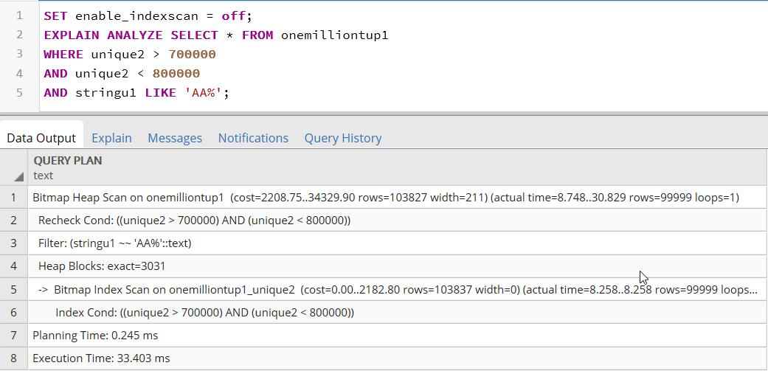
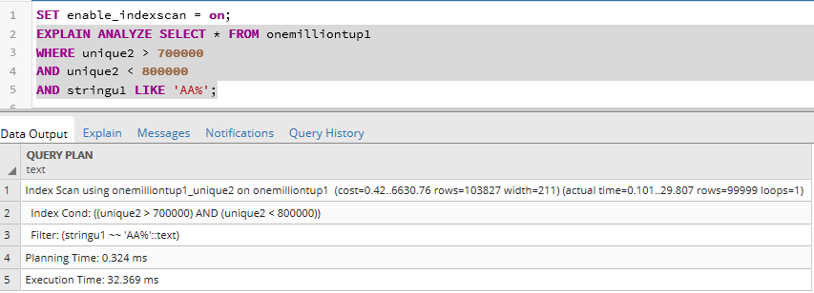
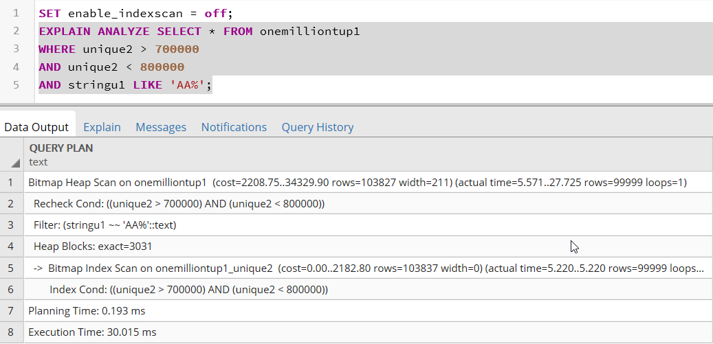
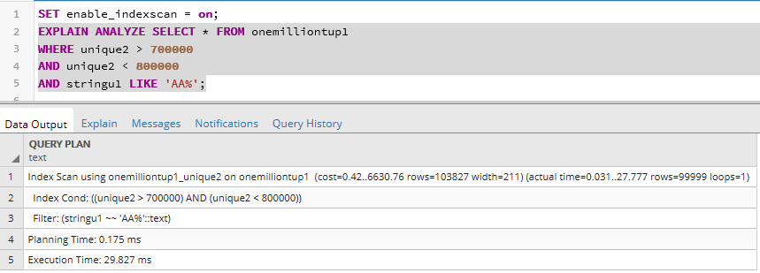
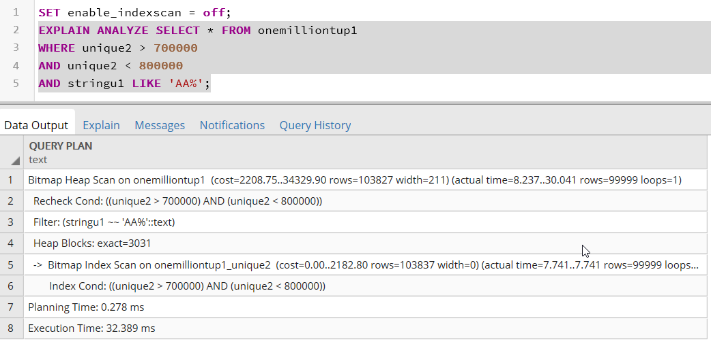

Execution times with enable_indexscan = off
Execution times with enable_indexscan = on

Slide 6
Experiment 1 – Clustered and Non-Clustered Index Scan
Query 2:
CREATE INDEX onemilliontup1_unique1 ON onemilliontup1(unique1);
SET enable_indexscan = on; // with non-clustered index
SET enable_seqscan = off;
EXPLAIN ANALYZE SELECT * FROM onemilliontup1
WHERE unique1 > 500000
AND unique1 < 600000
AND stringu1 LIKE 'AA%';
The goal is to compare performance (execution times) of clustered and non-clustered index scans with nearly 10% selectivity (99999 rows out of 10,00,000 rows) with enabling enable_indexscan parameter.
The results obtained were partially different from expected results.
Expected Result: As there is unclustered index on unique1 column, the query is expected to execute with non-clustered index scan since selectivity is slightly lesser than 10% and with more execution time than clustered index scan.
Result Obtained: The obtained result is partially different in a way that the query is executed with Bitmap Heap scan and Bitmap Index scan instead of non-clustered index on unique1 and as expected the execution time with clustered index is far lesser than bitmap heap scan.
Average Execution time with clustered index scan = 30.43 ms
Average Execution time with non-clustered index scan = 529 ms

Slide 7
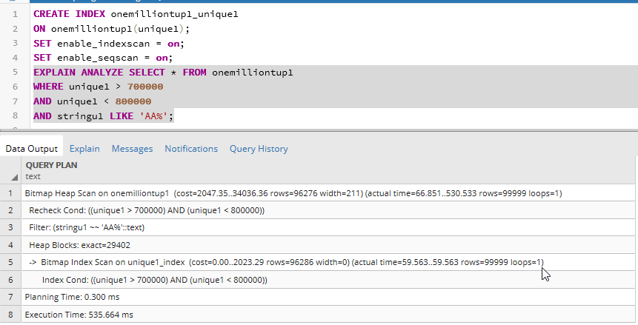
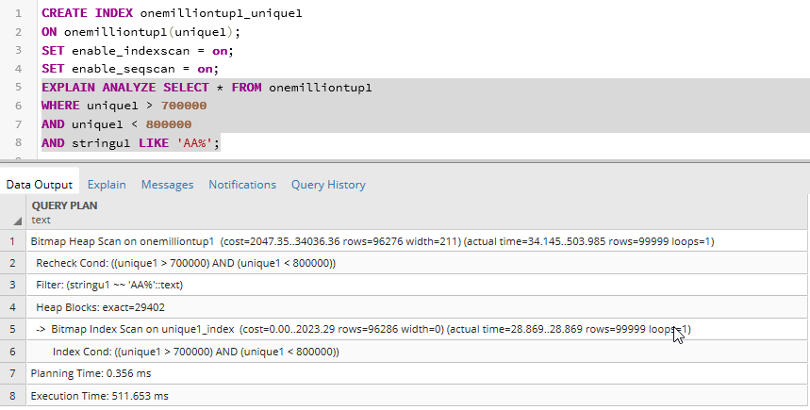
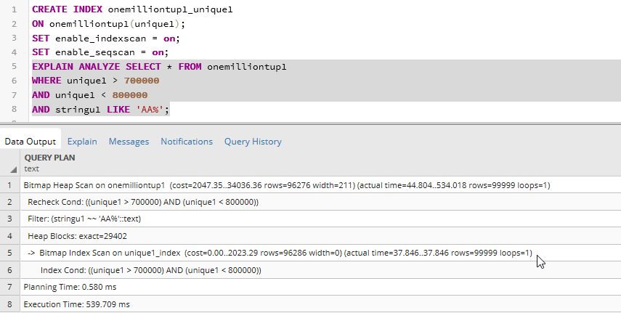
Execution times with clustered index scan
Execution times with non-clustered index scan

Slide 8
Experiment 2 – Hashing and Grouping Aggregation
Query 1:
SET work_mem = '20MB’; // with clustered index and explicit work_mem setting
SET enable_hashagg = on; // enable hashing aggregation
SET enable_indexscan = on;
EXPLAIN ANALYZE SELECT COUNT(unique2) FROM onemilliontup1
WHERE unique2 > 900000
GROUP BY tenPercent
HAVING tenPercent > 2;
The goal is to compare performance (execution times) of aggregation query with enabling and disabling enable_hashagg parameter.
The results obtained were same as the expected results.
Expected Result & Result Obtained: The execution time of aggregation query with hashing aggregation is less than the execution time with grouping aggregation.
Inference: Since selectivity is slightly less than 10% and also work_mem is assigned with more value (20MB) than default value (4MB), hence it has enough memory to fit the hash table in the memory and hence hashing aggregation will have less execution time than grouping aggregation. This is because grouping aggregation will sort all the rows and then groups them accordingly.
Average Execution time with enable_hashagg disabled = 64.58 ms
Average Execution time with enable_hashagg enabled = 34.83 ms

Slide 9
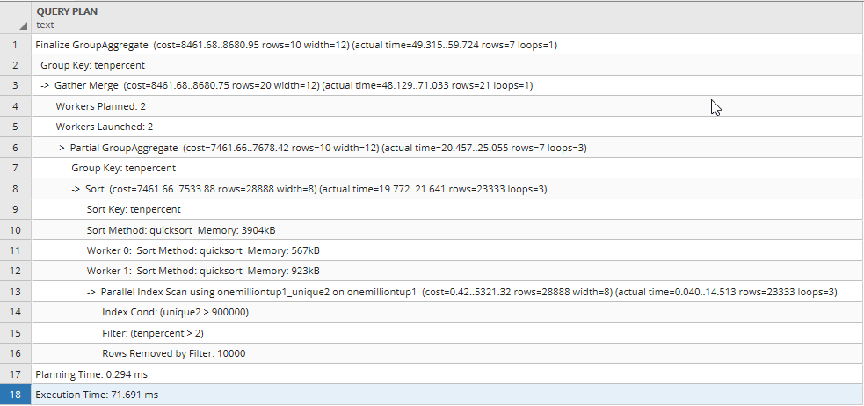
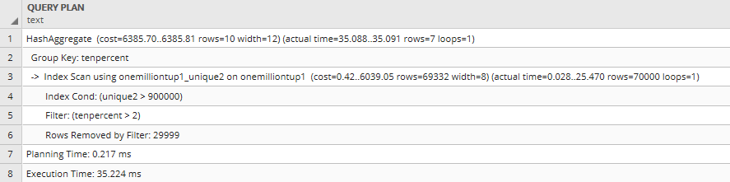
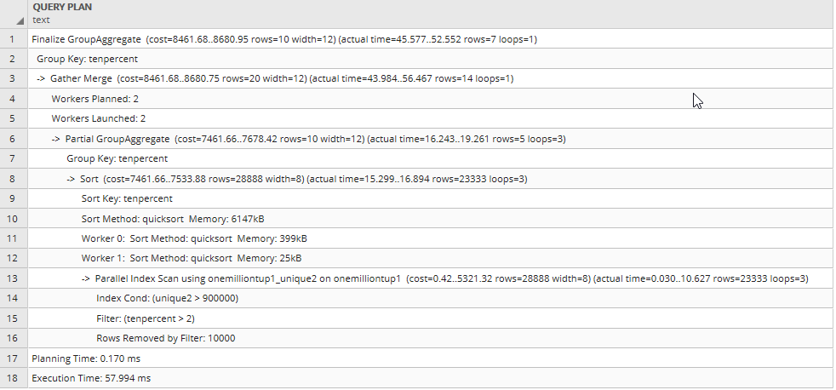
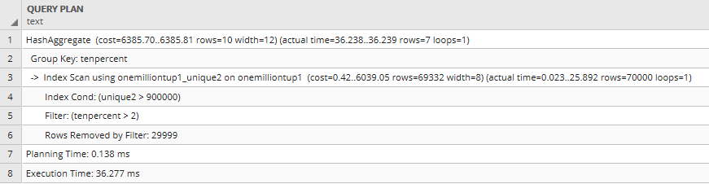
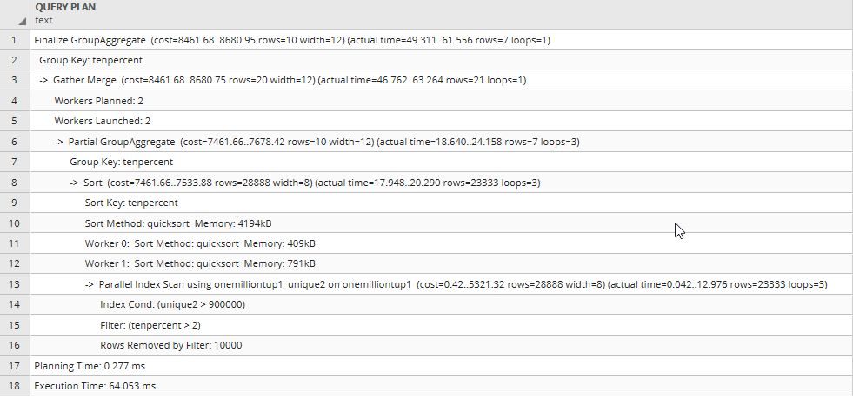
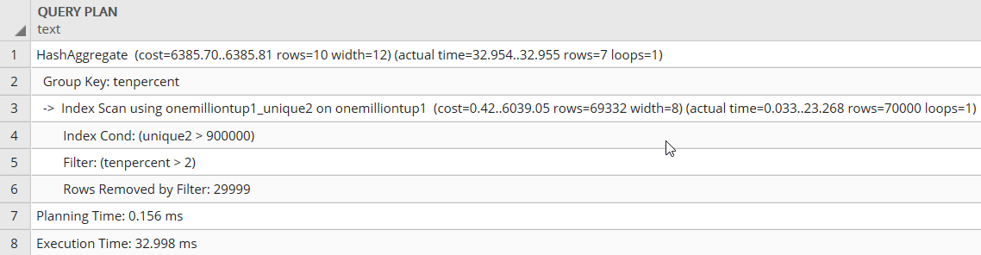
With enable_hashagg = off
With enable_hashagg = on

Slide 10
Experiment 3 – Join Algorithms
Query 1:
SET enable_mergejoin = on;
SET enable_nestloop = on;
SET enable_hashjoin = on;
EXPLAIN ANALYZE SELECT * FROM onemilliontup1 O, tenktup T
WHERE T.unique1 < 1000
AND O.unique2 = T.unique2
The goal is to learn which type of join queries which joins with disabling parameters like enable_hashjoin, enable_mergejoin, enable_nestloop
The results obtained were different from the expected results.
Expected Result: Intially all enable_hashjoin, enable_mergejoin, enable_nestloop are enabled by default. Since one of the relation is smaller (10,000 rows) and other relation is larger(1000,000 rows) with almost 100x size difference, the join query above was expected to executed with hash join algorithm or either in other case it was expected to execute with index nested loop join as there is an clustered index on unique2 column and non-clustered index on unique1 column.
Results Obtained as below:
enable_mergejoin = on (default) With enable_hashjoin = on (default) enable_nestloop = on (default) Expected: Hashjoin Result obtained: Mergejoin Average Execution time: 5.06 ms | enable_mergejoin = off enable_hashjoin = on enable_nestloop = on Expected: Hash join Result obtained: Index nested loop Average Execution time: 2.52 ms | enable_mergejoin = off enable_hashjoin = off enable_nestloop = on Expected: Index nested loop Result obtained: Index nested loop Average Execution time: 240.28 ms

Slide 11
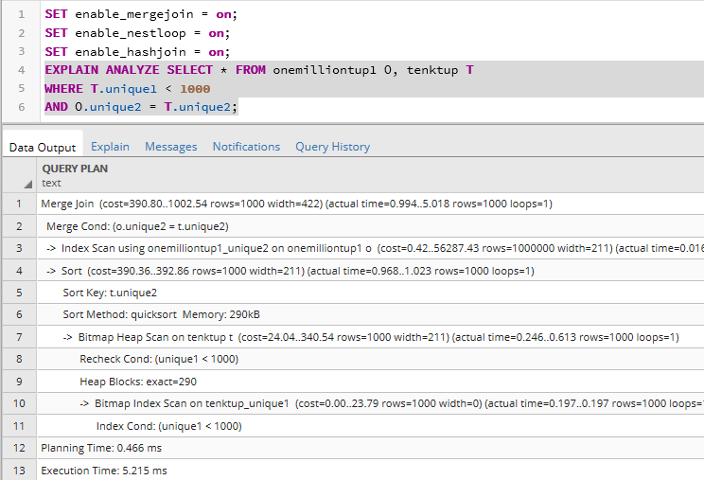
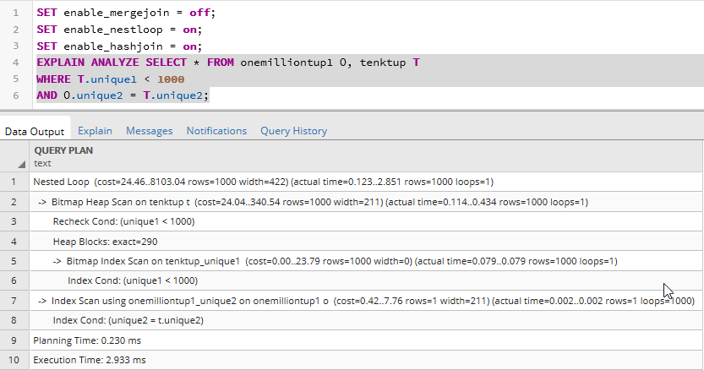
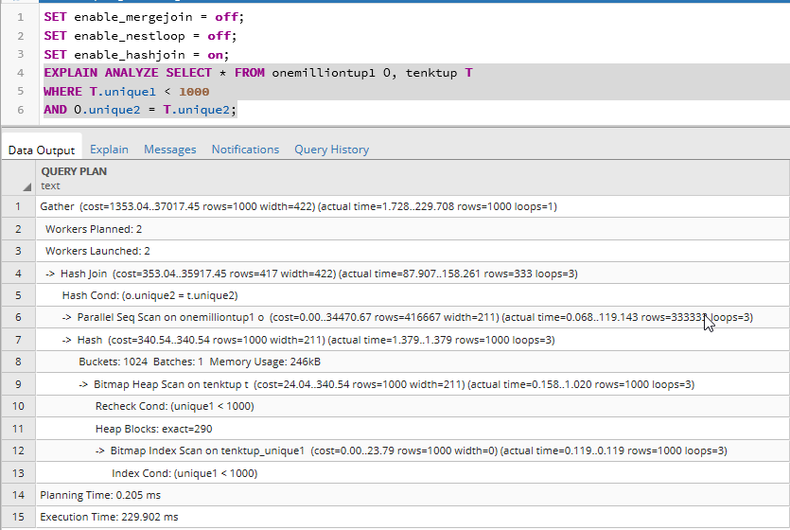
Inference: Even though one of the relation is much smaller than the other relation, the query planner has chosen merge join over hash join. This is because the execution time with merge join is far less than with hash join. This behavior could have happened because the unique2 row is primary key and hence the data is already sorted in which merge join performs more efficiently irrespective of the relations sizes. Also the execution times with merge join and index nested loop join are nearly same and since data is already on unique2, the query planner would have selected merge join over index nested loop join.

Slide 12
Experiment 4 – work_mem impact on DISTINCT & ORDER BY
Query 1:
SET work_mem = '256MB'
EXPLAIN ANALYZE SELECT DISTINCT(O1.unique3)
FROM onemilliontup1 O1
ORDER BY O1.unique3
The goal is to compare performance of query with DISTINCT AND ORDERBY clauses with varying work_mem parameter.
The results obtained were same as the expected results.
Expected Result & Result Obtained: The execution time of query with DISTINCT and ORDERBY clauses with default work_mem value of 4MB should be far more than (nearly 8x times) with work_mem = 256 MB which is set explicitly.
Inference: work_mem specifies the amount of memory to be used by internal sort operations. Since DISTINCT and ORDERBY performs sort operations, hence assigning more memory results in lesser execution. Hence execution time for sorting queries with more memory assigned is lesser than those sorting queries with default amount of memory (4MB) assigned.
Average Execution time with default work_mem value = 6586.76 ms
Average Execution time with enable_hashagg enabled = 750.3 ms

Slide 13
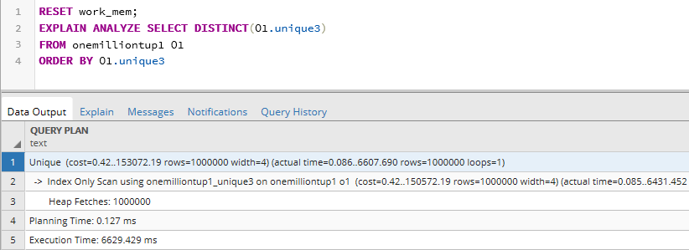
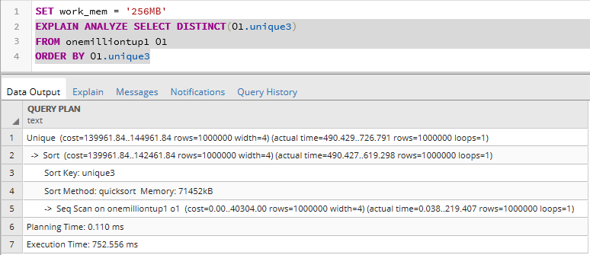
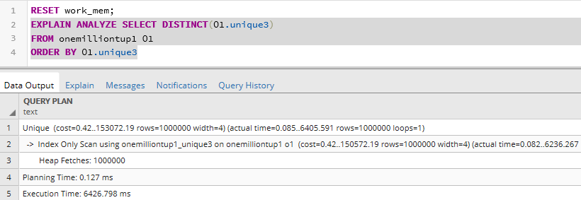
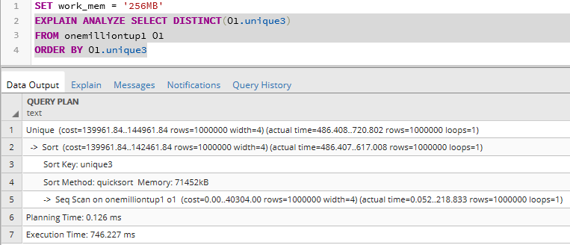
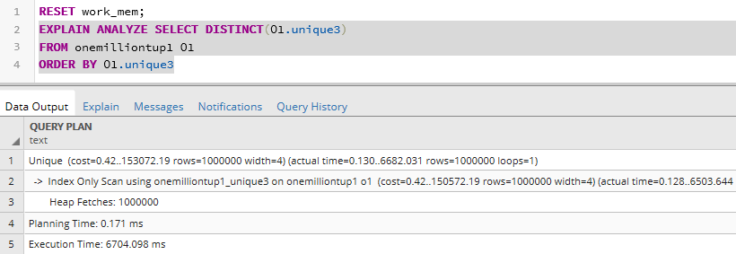
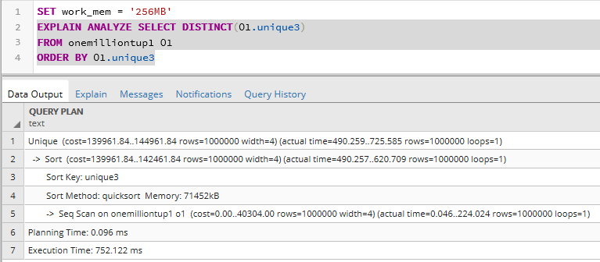
RESET work_mem (default value = 4MB)
SET work_mem = 256MB

Slide 14
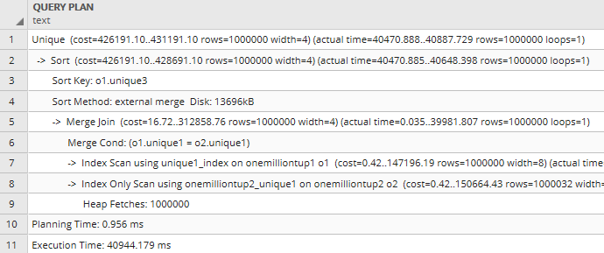
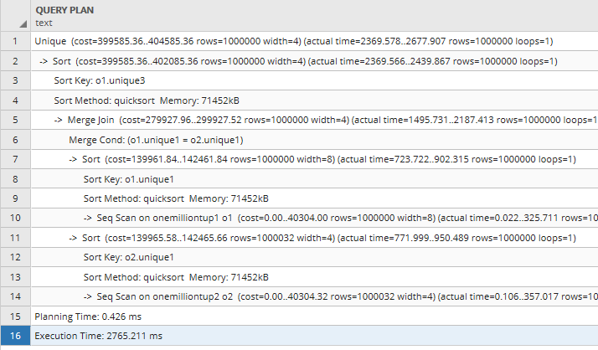
Experiment 4 – work_mem impact on Merge sort
with work_mem = 4 MB with work_mem = 256 MB
Query 2:
RESET work_mem;
SET enable_hashjoin = off;
EXPLAIN ANALYZE SELECT DISTINCT(O1.unique3)
FROM onemilliontup1 O1 INNER JOIN onemilliontup2 O2
ON O1.unique1 = O2.unique1
ORDER BY O1.unique3;
The goal is to compare performance of query with Merge sort with varying work_mem parameter.
The results obtained were same as the expected results.
Expected Result & Result Obtained: The execution time of query with merge sort with default work_mem value of 4MB should be far more than (nearly 8x times) with work_mem = 256 MB which is set explicitly.
Inference: work_mem specifies the amount of memory to be used by internal sort operations. Since merge sort performs sort operations, hence assigning more memory results in lesser execution. Hence execution time for sorting queries with more memory assigned is lesser than those sorting queries with default amount of memory (4MB) assigned.
Average Execution time with default work_mem value = ms
Average Execution time with enable_hashagg enabled = 750.3 ms

Slide 15
Summary:
Through four experiments after running different types of queries we have inferred few points:
From experiment 1, we observed that Bitmap scan occurs when select reads too less for sequential scan but too large for index scan. Since the selectivity is 10%, it could be too small for sequential scan and hence even after disabling enable_indexscan, it would have executed with bitmap scan. Also in some instances the query is executed with Bitmap Heap scan and Bitmap Index scan instead of non-clustered index on unique1 even though selectivity is 10% and as expected the execution time with clustered index was far lesser than bitmap heap scan.
From experiment2, we observed that when selectivity is slightly less than 10% and when work_mem is assigned with more value (20MB) than default value (4MB), hence it has enough memory to fit the hash table in the memory and hence hashing aggregation will have less execution time than grouping aggregation. This is because grouping aggregation will sort all the rows and then groups them accordingly.
From experiment3, we observed that even though one of the relation is much smaller than the other relation, the query planner has chosen merge join over hash join. This is because the execution time with merge join is far less than with hash join. This behavior could have happened because the unique2 row is primary key and hence the data is already sorted in which merge join performs more efficiently irrespective of the relations sizes. Also the execution times with merge join and index nested loop join are nearly same and since data is already on unique2, the query planner would have selected merge join over index nested loop join.
From experiment4, we observed that work_mem specifies the amount of memory to be used by internal sort operations. Since DISTINCT, ORDER BY, merge join performs sort operations, hence assigning more memory results in lesser execution. Hence execution time for sorting queries with more memory assigned is lesser than those sorting queries with default amount of memory (4MB) assigned.

Slide 16
Lessons learnt:
While analyzing the different scans with configuration parameters learnt about Bitmap heap and index scan which was being used in some instances and how it is different from index scans we learnt in the class.
Learnt about different configuration parameters Query Planning parameters and Resource Consumption parameters and how much they play key factor in influencing the query plans chosen by the query optimizer.
Learnt that sometimes default plans chosen by the optimizer for a particular query are not optimal, and by changing the parameter values can sometimes result in tremendous improvement in performance.
Analyzing the expected results of a query by applying the theoretical concepts learnt in the class might vary from result obtained when query is actually executed and observed that the system conditions are not ideal as assumed in theory and there are few factors like memory, size of relations, etc., that influence the query execution in real time.
The project has given us chance to learn and understand query plans in detail especially the join algorithms query plans like batch sizes, disk spaces consumed etc.,
It was fun trying around with different configuration parameters and experiencing the joy of faster execution of queries.

Slide 17
References:
1. The Wisconsin Benchmark: Past, Present, and Future - David J. DeWitt, Computer
Sciences Department, University of Wisconsin
2. Portland State University CS 587 course material
3. www.python.org/
4. www.postgresql.org/
5. www.postgresqltutorial.com/
6. www.postgresql.org/docs/9.4/runtime-config-resource.html
7. https://www.postgresql.org/docs/9.4/runtime-config-query.html
8. wiki.postgresql.org/wiki/Python/
9. www.cybertec-postgresql.com/en/postgresql-indexing-index-scan-vs-bitmap-scan-vs-sequential-scan-basics/

